Slide 1
College Staff Data Management

Slide 2
Introduction
The College Staff Data Management Software provides to store and access staff data easily. This software helps to store Teaching and Non Teaching staff data and it provides different type of accessing modules like Experience Data, Service Data, Department Exam Data etc.
What are Features of College Staff Data Management Software?
Store and Access of Teacher Complete Data.
Store and Access Service Data.
Store and Access Department Exam Data.
Store and Access RC / OC / Short Term Course / Workshop / Training / FDP / Conference / Seminar Data.
Store and Access Paper Data.
Book Published Data.
Project Minor / Major Data.
Etc.

Slide 3
Aim of Our Project
College staff data management is a one of the complex task. Now the traditional system is already digitalized, but that system can’t provides required type of data reports and accessing modules. This software is developed to fetch required type of data and reports of staff.
It is designed to overcome present system problems.
To reduce manual works.
To save time.
Simplified User Interface
Easy Access of Staff Data
Etc.

Slide 4
Existing System
Existing system already replaced traditional system, but it doesn’t have some features.
It has some limitations.
Data Accessing is difficult.
It is digitalized software but college staff data completely not managed with existing system.
Existing system is present but when fetching some data the user need to be do some manual work for fetching and organizing.
It doesn’t store complete staff data like committee membership, BOS / BOE etc data.

Slide 5
Requirements
Hardware Requirements
Processor : Dual Core Processor or Higher CPU
RAM : 2GB
HARD DISK / SSD : 120GB
MONITOR : 18.5 inch or Higher
Required Resolution: 1366x768 Pixels
Keyboard: 102 Standard Keyboard
Mouse : Standard Mouse
Software Requirements
Operating System : Windows 7 or Higher
Languages : PHP
Software : XAMPP
Web Server : Apache
Database : MYSQL
Front End : HTML, CSS, JAVASCRIPT, jQuery
BACK END : PHP, MYSQL

Slide 6
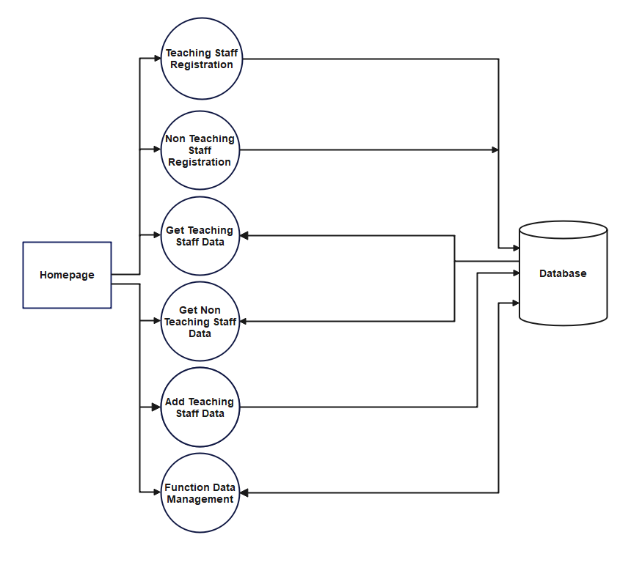
Data Flow Diagram

Slide 7
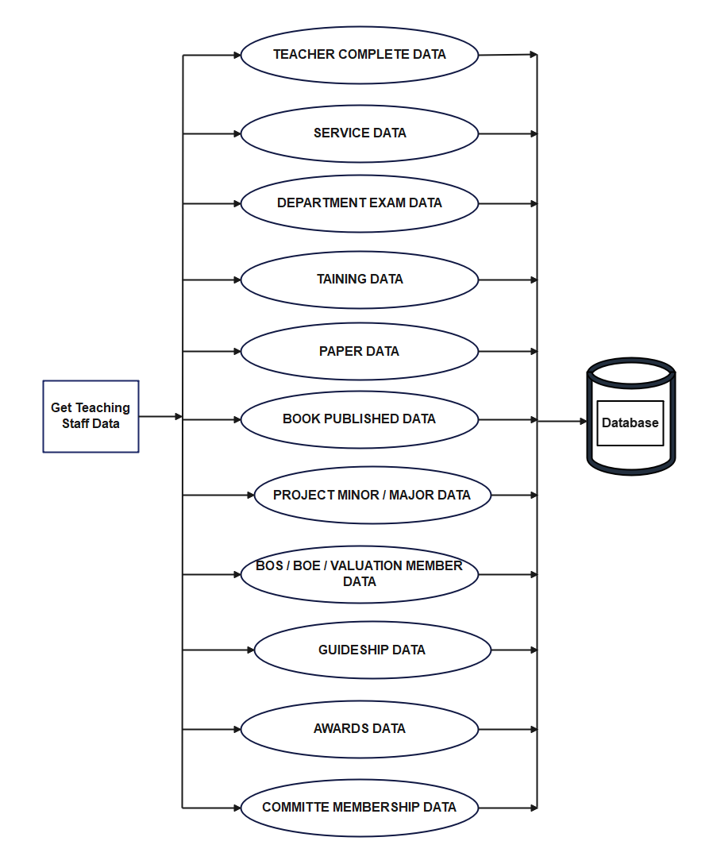
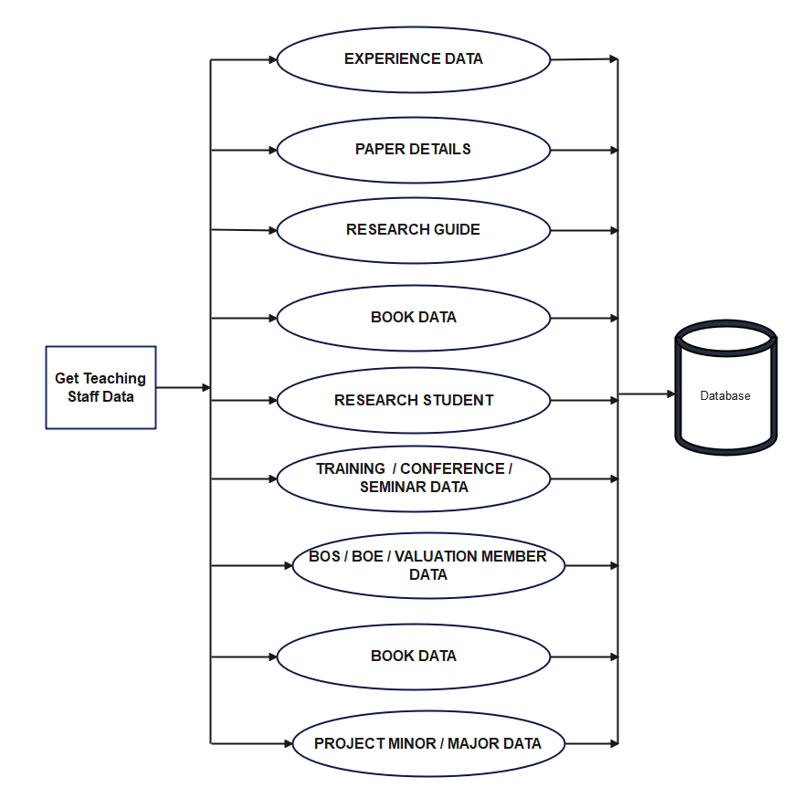
Get Teaching Staff Data – Data Flow Diagram (DFD)
TEACHER DATA EMPLOYEE NAME WISE
TEACHER DATA YEAR WISE

Slide 8
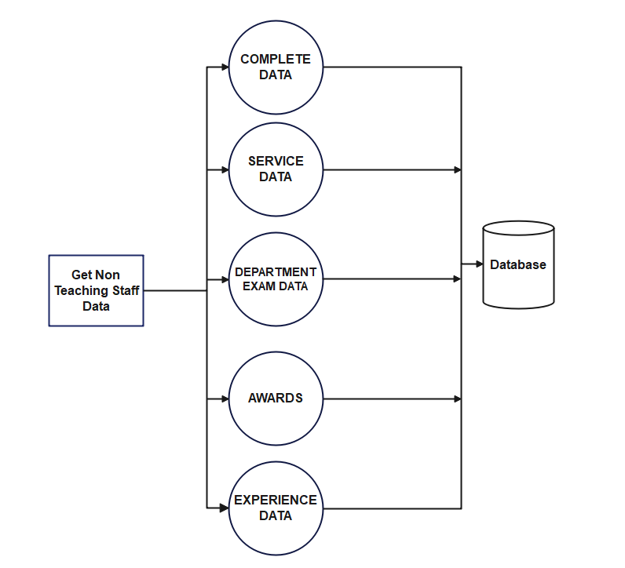
Get Non Teaching Staff Data - Data Flow Diagram (DFD)

Slide 9
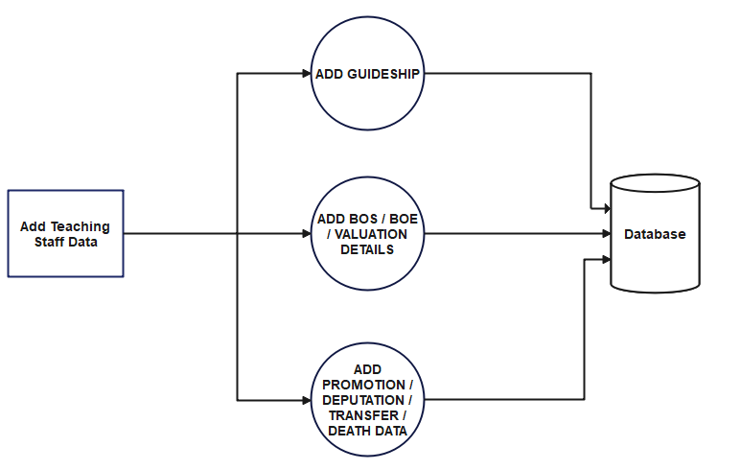
Add Teaching Staff Data - Data Flow Diagram (DFD)

Slide 10
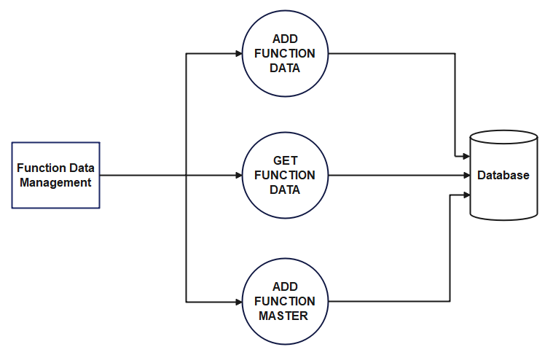
Function Data Management - Data Flow Diagram (DFD)

Slide 11
Modules
Teaching Staff Registration
Non Teaching Staff Registration
Get Teaching Staff Data
Get Non Teaching Staff Data
Add Teaching Staff Data
Function Data Management

Slide 12
Teaching Staff Registration
It accepts complete Teaching Staff Data Like Personal Information, Qualification Details, Service Data, Department Exam Data, Award Data, Book Published Data, Committee Membership Data, RC / OC / Short Term / Training / FDP / Conference / Seminar Data, Paper Data, Project Minor / Major Data.
It accepts photo and certificates.
It Saves the all data into database

Slide 13
Non Teaching Staff Registration
It accepts complete Teaching Staff Data Like Personal Information, Qualification Details, Service Data, Department Exam Data and Award Data.
It accepts photo and certificates.
It Saves the all data into database

Slide 14
Get Teaching Staff Data
This module gives access of Teaching Staff data. In This module has different type of data access links.
EMPLOYEE WISE DATA
Teacher Complete Data
Service Data
Department Exam Data
RC / OC / SHORT TERM COURSE / WORKSHOP /TRAINING / FDP / CONFERENCE / SEMINAR DATA
Paper Data
Book Published Data
Project Minor Major Data
BOS / BOE / Valuation Member Data
Guideship Data
Awards Data
Committee Membership Data

Slide 15
Get Teaching Staff Data
YEAR WISE DATA
Experience Data
Paper Details
Research Guide
Book Data
Research Student
RC / OC / Short Term Course / Workshop / Training / FDP / Conference / Seminar Data
BOS / BOE / Valuation Member Data
Book Data
Project Minor / Major Data
Committee Data

Slide 16
Get Non Teaching Staff Data
This module gives access of Non Teaching Staff data. In This module has different type of data access links.
EMPLOYEE WISE DATA
Teacher Complete Data
Service Data
Department Exam Data
Award Data
Experience Data

Slide 17
Add Teaching Staff Data
It gives some links to add teaching staff data. There are following below.
Add Guideship
In this sub module it accepts Guideship Data.
Add BOS / BOE / Valuation Details
In this sub module it accepts BOS / BOE / Valuation Data.
Add Promotion / Deputation / Transfer / Death Data
In this sub module it accepts Promotion / Deputation / Transfer / Death Data.

Slide 18
Function Data Management
This module gives to manage college events data.
It has 3 sub modules.
Add Function Data
It accepts Function Organizer, Coordinator, Resource Person and Event Images.
Get Function Data
It displays Function Organizer, Coordinator, Resource Person and Event Images.
Add Function Master
It accepts function organizer and it stored into organizer table.

Slide 19
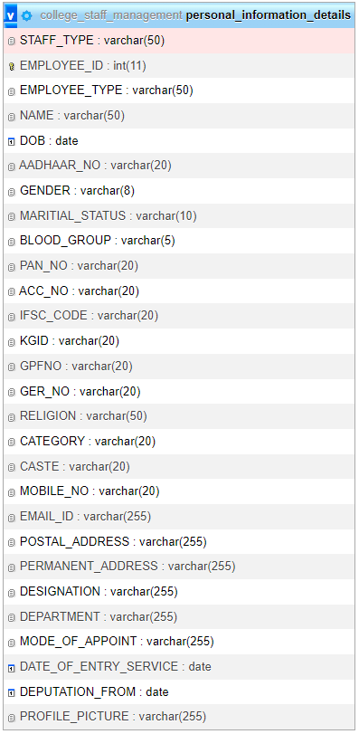
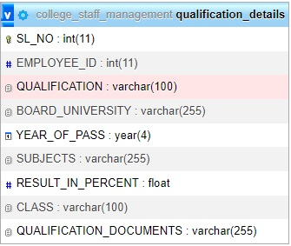
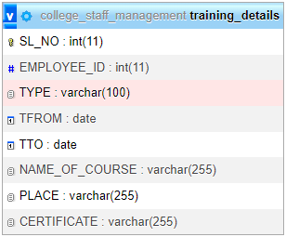
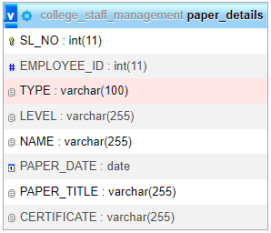
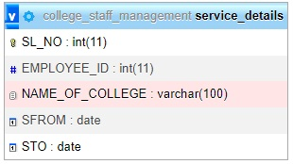
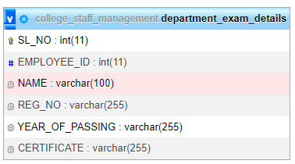
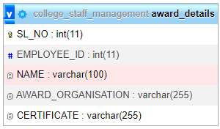
Data Base Information

Slide 20
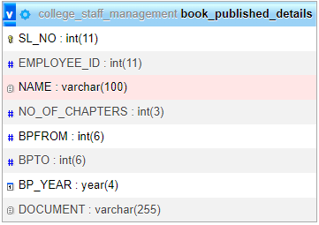
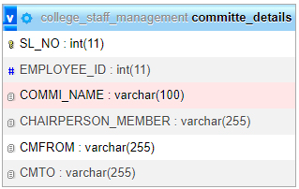
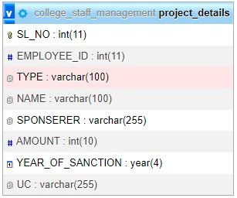
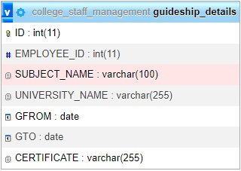
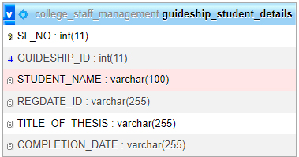
Data Base Information

Slide 21
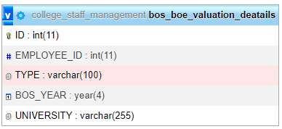
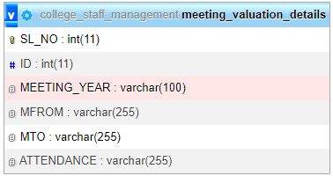
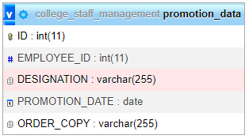
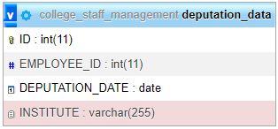
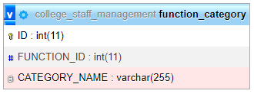
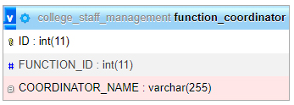
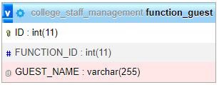
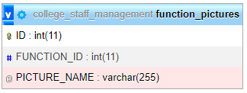
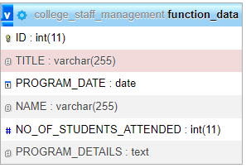

Data Base Information

Slide 22
Conclusion
Our project is only a humble venture to satisfy the needs to manage their Staff profile information. Several user-friendly coding has also adopted. This package shall prove to be a powerful package in satisfying all the requirements of the college. The objective of web application is to collect the information and store in data. The authority member can fetch the stored information. This application is successfully implemented with all the features mentioned in system requirement specification. Awareness and right information about staff are essential for collect rightful information.

Slide 23
Feature Enhancement
➢ We can add printer in future.
➢ We can give more advance software for Staff Management System including more facilities
➢ We will host the platform on online servers to make it accessible worldwide
➢ Integrate multiple load balancers to distribute the loads of the system
➢ Create the master and slave database structure to reduce the overload of the database queries
➢ Implement the backup mechanism for taking backup of codebase and database on regular basis on different servers.

